Slide 1
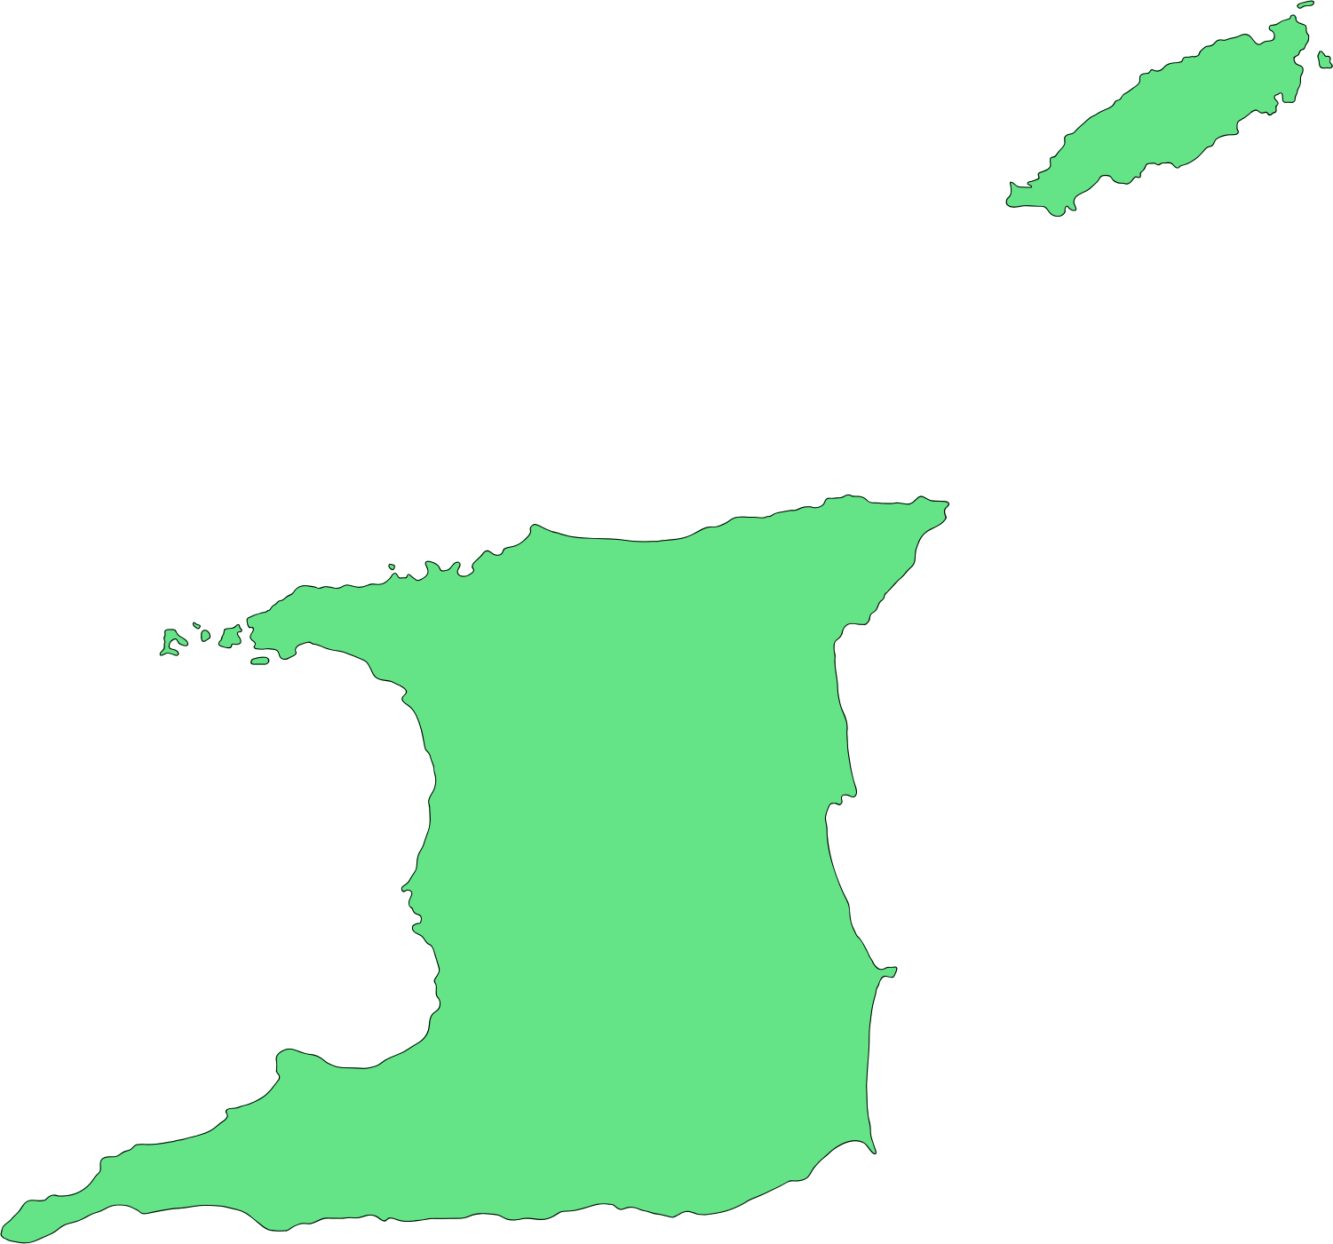

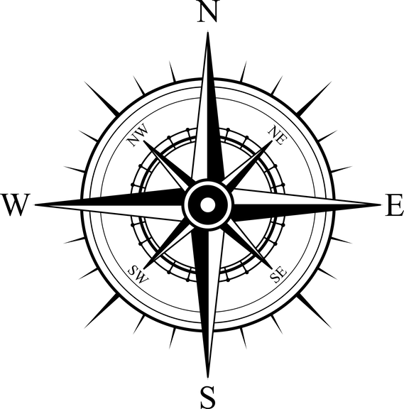




Tobago
Trinidad
Northern Range
Central Range
Southern Range
Main Ridge

